Slide 1



jQuery- A Look Ahead
jQuery - simplifies JavaScript programming.

Slide 2

Overview
What is jQuery?
jQuery – library
jQuery Syntax
jQuery Selectors
jQuery Events
jQuery CallBack
jQuery HTML Manipulation
jQuery CSS Manipulation
jQuery AJAX Manipulation
Conclusion

Slide 3

What is jQuery?
jQuery is a fast and concise JavaScript Library.
Simplifies HTML document traversing, event handling, animating, and Ajax interactions for rapid web development.
jQuery greatly simplifies JavaScript programming.
jQuery is easy to learn.
jQuery is a lightweight "write less, do more" JavaScript library.

Slide 4
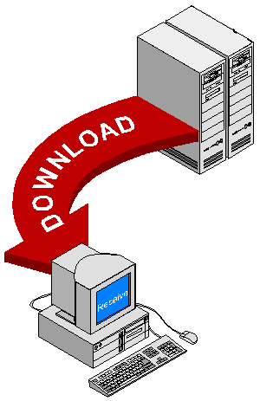
Downloading jQuery
Two versions of jQuery are available for downloading: one minified and one uncompressed (for debugging or reading).
Both versions can be downloaded from jQuery.com.

Slide 5
jQuery Syntax

Slide 6

jQuery Syntax
The jQuery syntax is tailor made for selecting HTML elements and perform some action on the element(s).
Normally all jQuery methods, are inside a document.ready() function:
  $(document).ready(function(){
  // jQuery functions go here...
  });
This is to prevent any jQuery code from running before the document is finished loading.
Basic syntax is: $(selector).action()
  A dollar sign to define jQuery
  A (selector) to "query (or find)" HTML elements
  A jQuery action() to be performed on the element(s).
A jQuery action() to be performed on the element(s).

Slide 7

jQuery Syntax
With jQuery you select (query) HTML elements and perform "actions" on them.
jQuery Syntax Examples
$(this).hide()
Demonstrates the jQuery hide() method, hiding the current HTML element.
$("#test").hide()
Demonstrates the jQuery hide() method, hiding the element with id="test".
$("p").hide()
Demonstrates the jQuery hide() method, hiding all <p> elements.
$(".test").hide()
Demonstrates the jQuery hide() method, hiding all elements with class="test".

Slide 8
jQuery Selectors

Slide 9

jQuery Selectors
jQuery selectors allow you to select and manipulate HTML elements as a group or as a single element.
jQuery selectors allow you to select HTML elements (or groups of elements) by element name, attribute name or by content.
Mainly there are Three Types of Selectors
  jQuery Element Selectors
  jQuery Attribute Selectors
  jQuery CSS Selectors

Slide 10

jQuery Element Selectors
jQuery uses CSS selectors to select HTML elements.
  $("p") selects all <p> elements.
  $("p.intro") selects all <p> elements with class="intro".
  $("p#demo") selects the first <p> element with id="demo".

Slide 11
jQuery Attribute Selector
jQuery uses XPath expressions to select elements with given attributes.
  $("[href]") select all elements with an href attribute.
  $("[href='#']") select all elements with an href value equal to "#".
  $("[href!='#']") select all elements with an href attribute NOT equal to "#".
  $("[href$='.jpg']") select all elements with an href attribute that ends with ".jpg".

Slide 12
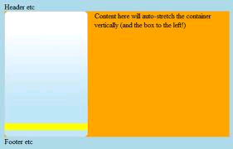
jQuery CSS Selectors
jQuery CSS selectors can be used to change CSS properties for HTML elements.
The following example changes the background-color of all p elements to yellow:
Example
$("p").css("background-color","yellow");

Slide 13
jQuery Events

Slide 14

jQuery Events
jQuery is tailor made to handle events.
The jQuery event handling methods are core functions in jQuery.
Event handlers are method that are called when "something happens" in HTML. The term "triggered (or "fired") by an event" is often used.

Slide 15
jQuery Events (CONTINUE)
Event Method
Description
$(document).ready(function)
Binds a function to the ready event of a document
(when the document is finished loading)
$(selector).click(function)
Triggers, or binds a function to the click event of selected elements
$(selector).dblclick(function)
Triggers, or binds a function to the double click event of selected elements
$(selector).focus(function)
Triggers, or binds a function to the focus event of selected elements
$(selector).mouseover(function)
Triggers, or binds a function to the mouseover event of selected elements

Slide 16
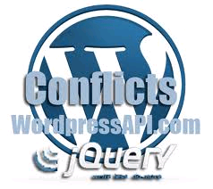
jQuery Name Conflicts
jQuery uses the $ sign as a shortcut for jQuery.
Some other JavaScript libraries also use the dollar sign for their functions.
The jQuery noConflict() method specifies a custom name (like jq), instead of using the dollar sign.

Slide 17

jQuery Name Conflicts
Example
<script type="text/javascript">
var jq=jQuery.noConflict();
jq(document).ready(function(){
jq("button").click(function(){
jq("p").hide();
});
});
</script>

Slide 18
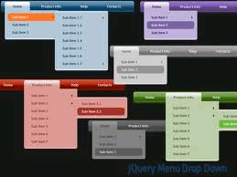
jQuery Effects

Slide 19

jQuery Effects
Using jQuery you can use certain effects like Hide, Show, Toggle, Slide, Fade, and Animate, etc in our application.
Examples
  jQuery hide()
  Demonstrates a simple jQuery hide() method.
  jQuery hide()
  Another hide() demonstration. How to hide parts of text.
  jQuery slideToggle()
  Demonstrates a simple slide panel effect.
  jQuery fadeTo()
  Demonstrates a simple jQuery fadeTo() method.
  jQuery animate()
  Demonstrates a simple jQuery animate() method.

Slide 20
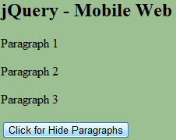

jQuery Effects-Hide &Show
With jQuery, you can hide and show HTML elements with the hide() and show() methods.
The speed parameter specifies the speed of the hiding/showing, and can take the following values: "slow", "fast", "normal", or milliseconds.
Example
Example
$("#hide").click(function(){
$("p").hide();
});
$("#show").click(function(){
$("p").show();
});
$("button").click(function(){
$("p").hide(1000);
});

Slide 21
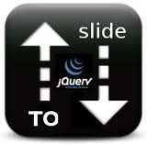
jQuery Slide
The jQuery slide methods gradually change the height for selected elements.
jQuery has the following slide methods:
  SlideDown
    $(selector).slideDown(speed,callback)
  slideUp
    $(selector).slideUp(speed,callback)
  slideToggle
    $(selector).slideToggle(speed,callback)

Slide 22
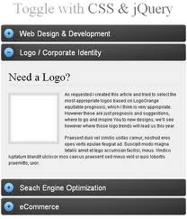
jQuery Slide
slideDown() Example
  $(".flip").click(function(){
  $(".panel").slideDown();
  });
slideUp() Example
  $(".flip").click(function(){
  $(".panel").slideUp()
  })
slideToggle() Example
  $(".flip").click(function(){
  $(".panel").slideToggle();
  });

Slide 23

jQuery Fade
The jQuery fade methods gradually change the opacity for selected elements.
jQuery has the following fade methods:
  fadeIn
    $(selector).fadeIn(speed,callback)
  fadeOut
    $(selector).fadeOut(speed,callback)
  fadeTo
    $(selector).fadeTo(speed,opacity,callback)

Slide 24
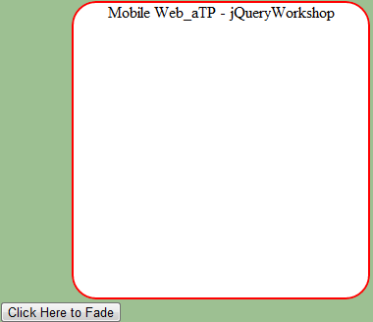
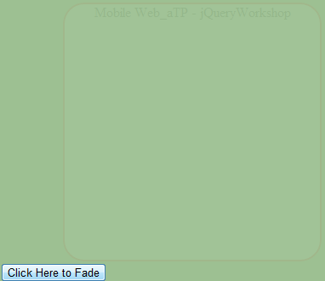
jQuery Fade (CONTINUE)
fadeTo() Example
  $("button").click(function(){
  $("div").fadeTo("slow",0.25);
  });
fadeOut() Example
  $("button").click(function(){
  $("div").fadeOut(4000);
  });

Slide 25
jQuery Custom Animations
By Using jQuery we can create animation effects in our website.
The syntax of jQuery's method for making custom animations is:
$(selector).animate({params},speed,callback);
The key parameter is params. It defines the CSS properties that will be animated. Many properties can be animated at the same time.
Example
    animate({width:"70%",opacity:0.4,marginLeft:"0.6in",fontSize:"3em"});
The second parameter is duration. It defines the time used to apply the animation. I takes the values "fast", "slow", "normal", or milliseconds.

Slide 26
jQuery CallBack

Slide 27

jQuery Callback Functions
A callback function is executed after the current animation is 100% finished.
JavaScript statements are executed line by line. However, with animations, the next line of code can be run even though the animation is not finished. This can create errors.
To prevent this, you can create a callback function. The callback function will not be called until after the animation is finished.
Typical syntax: $(selector).hide(speed,callback)
Example
  $("p").hide(1000,function(){
  alert("The paragraph is now hidden");
  });

Slide 28
jQuery HTML
Manipulation

Slide 29
jQuery HTML
Manipulation
jQuery contains powerful methods (functions) for changing and manipulating HTML elements and attributes.
Changing HTML Content
  $(selector).html(content)
Example
  $("p").html(“Aitrich Technologies");

Slide 30
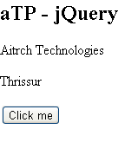
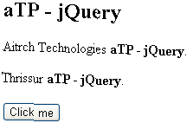
Adding HTML content
$(selector).append(content)
  The append() method appends content to the inside of matching HTML elements.
$(selector).prepend(content)
  The prepend() method "prepends" content to the inside of matching HTML elements.
Example
  $("p").append(" Aitrich Technologies");

Slide 31
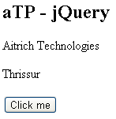
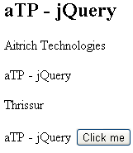
Adding HTML content
$(selector).after(content)
  The after() method inserts HTML content after all matching elements.
$(selector).before(content)
  The before() method inserts HTML content before all matching elements.
Example
  $("p").after(" Aitrich Technologies");

Slide 32
jQuery CSS Manipulation

Slide 33
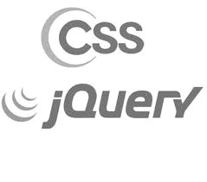
jQuery CSS
Manipulation
jQuery has one important method for CSS manipulation: css()
The css() method has three different syntaxes:
  css(name) - Return CSS property value
  css(name,value) - Set CSS property and value
  css({properties}) - Set multiple CSS properties and values

Slide 34
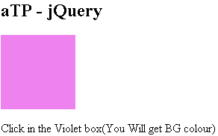
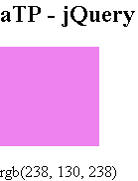
jQuery CSS Manipulation
Return CSS Property:
Use css(name) to return the specified CSS property value of the FIRST matched element:
Example
  $(this).css("background-color");

Slide 35
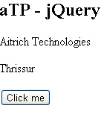
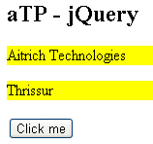
jQuery CSS Manipulation
Set CSS Property and Value:
Use css(name,value) to set the specified CSS property for ALL matched elements:
Example
  $("p").css("background-color","yellow");

Slide 36
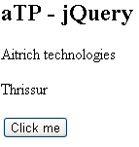
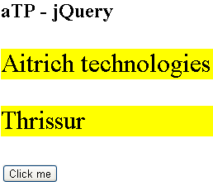
jQuery CSS Manipulation
Set Multiple CSS Property/Value Pairs:
Use css({properties}) to set one or more CSS property/value pairs for the selected elements:
Example
  $("p").css({"background-color":"yellow","font-size":"200%"});

Slide 37
jQuery- height() & width()
jQuery has two important methods for size manipulation.
  height()
  width()
Height
Width

Slide 38
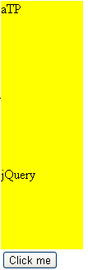
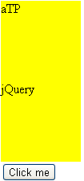
jQuery- height() & width()
Size Manipulation :-
The height() method sets the height of all matching elements:
Example
  $("#div1").height("200px");

Slide 39
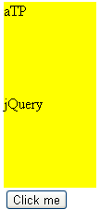
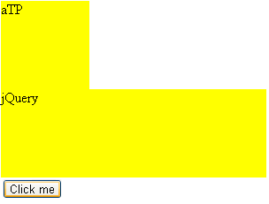
jQuery- height() & width()
Size Manipulation :-
The width() method sets the width of all matching elements:
Example
  $("#div2").width("300px");

Slide 40
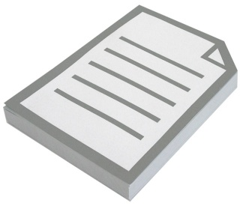
Example
  <script type="text/javascript">
  $(function() {
  $('#ButtonID').click(function(e) {
  var testValue = 'Test Value';
  $('#TextboxID').val(testValue);
  });
  });
  </script>

Slide 41
jQuery AJAX
Manipulation

Slide 42

jQuery AJAX
jQuery has a rich library of methods (functions) for AJAX development.
AJAX = Asynchronous JavaScript and XML.
AJAX is a technique for creating fast and dynamic web pages.

Slide 43
AJAX and jQuery
With jQuery AJAX, you can request TXT, HTML, XML or JSON data from a remote server using both HTTP Get and HTTP Post.
The jQuery load() method is a simple AJAX function. It has the following syntax:-
  $(selector).load(url,data,callback)
Use the selector to define the HTML element(s) to change, and the url parameter to specify a web address for your data.

Slide 44
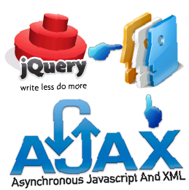
Low Level AJAX
$.ajax(options) is the syntax of the low level AJAX function.
$.ajax offers more functionality than higher level functions like load, get, and post, but it is also more difficult to use.
Example
    <script type="text/javascript">
    $(document).ready(function(){
    $("button").click(function(){
    $.ajax({url:"test1.txt", success:function(result){
    $("div").html(result);
    }});
    });});
    </script>

Slide 45

Question Time

Slide 46


